Slide 1
User Walkthrough
The Urbananas
Yung Chieh Huang (ych10)
Ji Wu (jw124)
Hanlin Wang (hanlinw4)
Siddharth Salunkhe (ss190)

Slide 2
Recap: Our Tasks at a Glance
Viewing a prompt after getting a notification, uploading art & critique related to that prompt.
Creating and sharing art with friends and inputting critiques later.
Viewing past works, milestone works and their associated critiques. Viewing accomplishments.

Slide 3
Updates based on last week’s feedback
Better error recovery and user feedback considerations (through toasts and other signifiers).
More icons that signify actions (edit icons, back buttons, home buttons).
Shallower navigation - keep app stack short.
More interactivity and reflection with accomplishments.

Slide 4
Methods - Test Subject Information
Description | Date/Length | Tasks evaluated | Method | Experience with similar apps
24 YO, Male, Medical Student | 10/25/2022 7PM 20 min | Uploading Image Update Critique View Milestones Change Notifications | In-person + printed screens of low-fi prototype | Workout trackers, Duolingo
26YO, Male, Sociology Student | 10/24/2022 9PM 30 min | Set Notifications Upload Images and Critiques View the Past Work View Milestones | In-person + printed screens of low-fi prototype | Simple Diary

Slide 5
Methods - Test Subject Information
Description | Date/Length | Tasks evaluated | Method | Experience with similar apps
23 YO, Female, LIS Student | 10/26/2022 1PM 15 min | Upload Images and Critique View Milestones | In-person + printed screens of low-fi prototype | Built-in notepad
23 YO,Female, Analyst | 10/26/2022 2PM 20 min | Adjust Notification Frequency Upload Images and Changing Critique View Milestones | In-person + printed screens of low-fi prototype | TickTick

Slide 6
User Reactions
Strengths:
Simple interface.
Easy to set multiple notifications and useful for busy people.
Easy to record the learning process.
Easy to upload images and critiques. Saves time and it’s personal.

Slide 7
User Reactions
Weaknesses:
Order of actions in upload workflow is not clear (save? upload? share?) .
No categorization for past works - group works by personal categories.
Change “Learning Goals “to “Achievements” as goals should be set by users, not the developers.
Want to share multiple images.
Need a way to access other people’s profile - makes critique easier.

Slide 8
Usability Problems
Behavior of save button is unclear
Needs more feedback on save - Where does the saved image/critique go?
Summary page for new images or does not take you away from page.
Unclear if it applies to just image or to critique + image.
Do you need to save before sharing?

Slide 9
Usability Problems
Creating vs Updating an image-critique has too many actions
There should not be upload buttons on update critique page.
Should have a way of deleting images you accidentally saved.
Tag critiques to different parts of image.
Tag images with words to help you search for them later.

Slide 10
Usability Problems
Viewing past works and milestones is difficult to locate and not holistic
It’s strange that Past Works is under Profile.
Achievements should be less hidden under Profile.
Should allow zoom into images in Past Works.
Profile should be “about me” info.

Slide 11
Usability Problems
It is not easy to input critiques from other people
Can other people have access to your account?
Can other people use the app just to post on your critiques?
Sharing images and copy-pasting from messages is too much work

Slide 12
Design Ideas - Landing Page
Create carousel of past works on landing page - makes it easier to see recent works and makes the landing page more action-oriented.
Add more navigation to the landing page - Profile, Settings, Milestones & Achievements, Upload - Shallower, easier to navigate and don’t have to hunt for pages.
Click on the prompt to randomize it.
Add identity: “Welcome <name>”

Slide 13
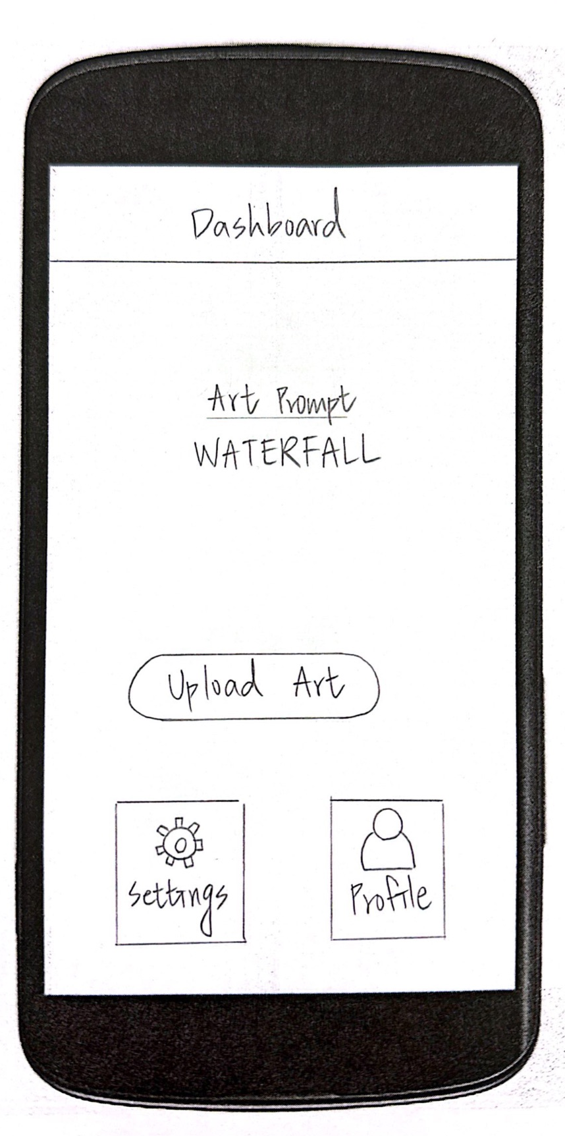
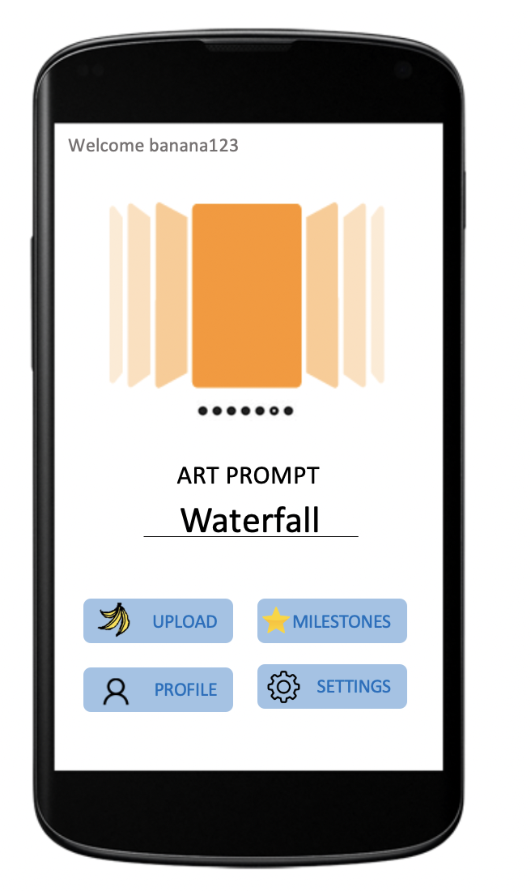
Design Ideas - Landing Page

Slide 14
Design Ideas - Upload Page
Change layout of upload page so that there is no middle upload button.
Remove the upload buttons on update pages.
Make sure the save indicates that art was added to past works gallery.
Make sure milestone button indicates that work was added to milestone gallery.
Make sure photo preview does not look like text box.
Make sure save button is grouped with both critique and image.

Slide 15
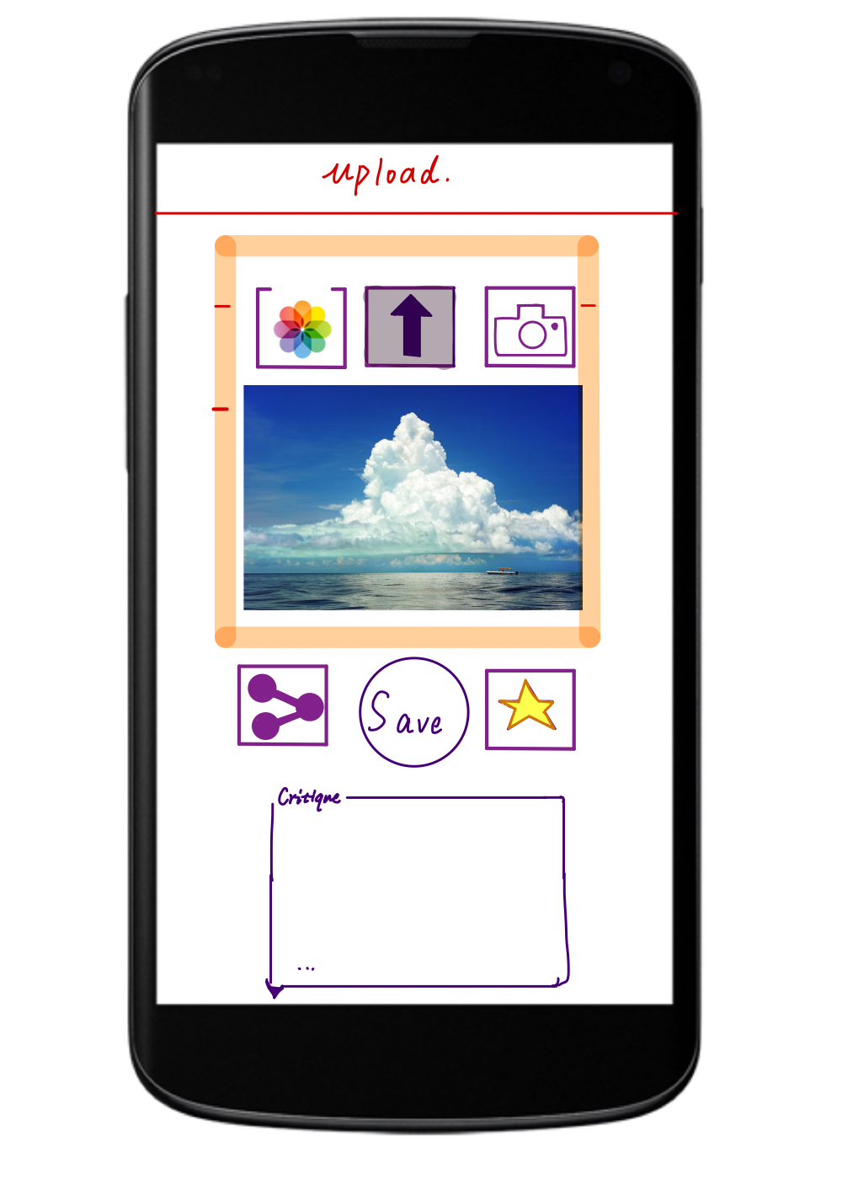
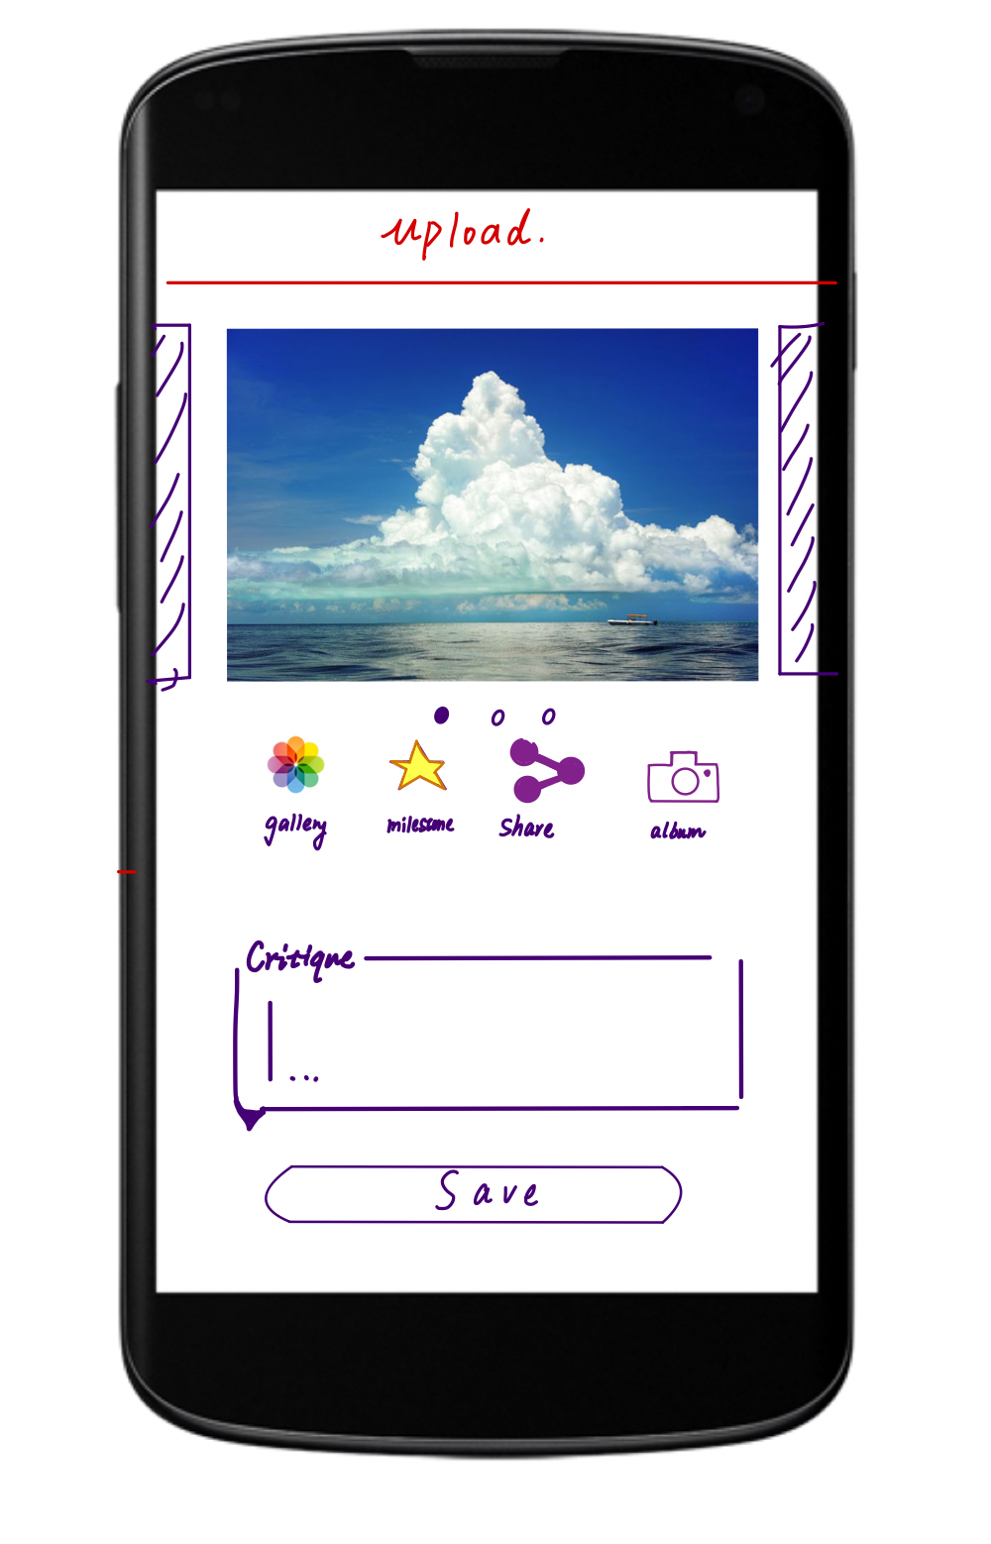
Design Ideas - Upload Page

Slide 16
Design Ideas - Past Works & Milestones
Tag each image with a user-defined tag so that when you filter images, you can search by date and tags.
Share multiple images from past works.
Progress bar to next achievement.

Slide 17
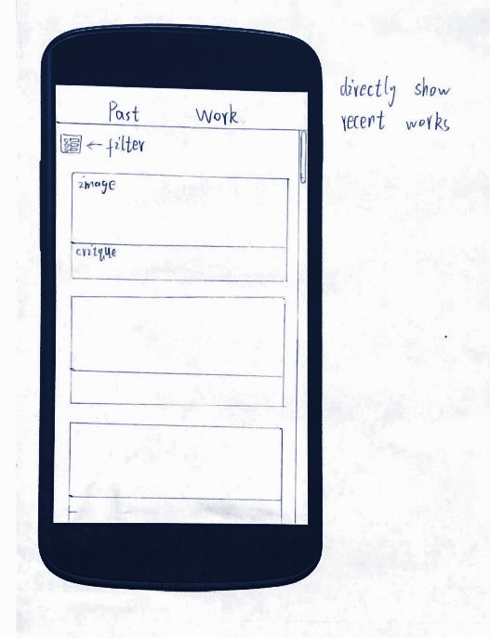
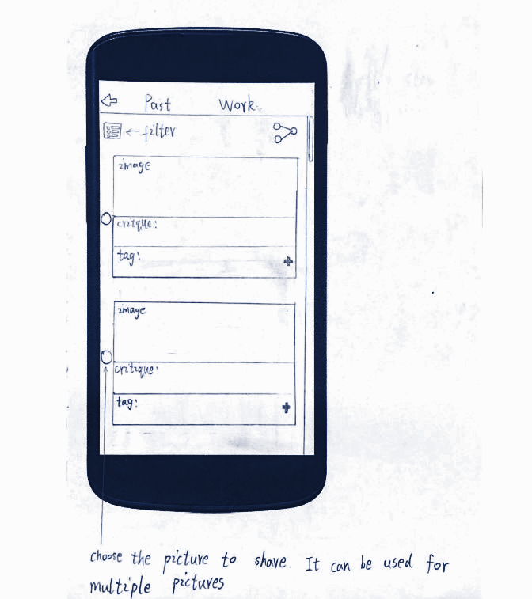
Design Ideas - Past Works & Milestones

Slide 18
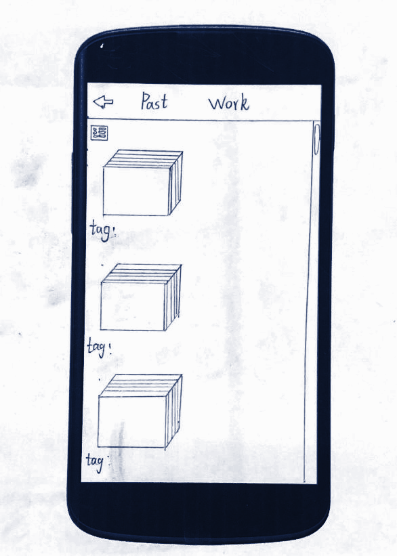
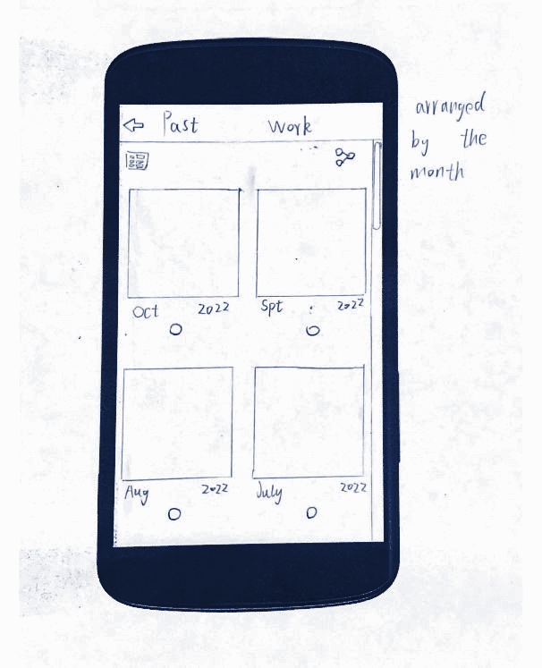
Design Ideas - Past Works & Milestones

Slide 19
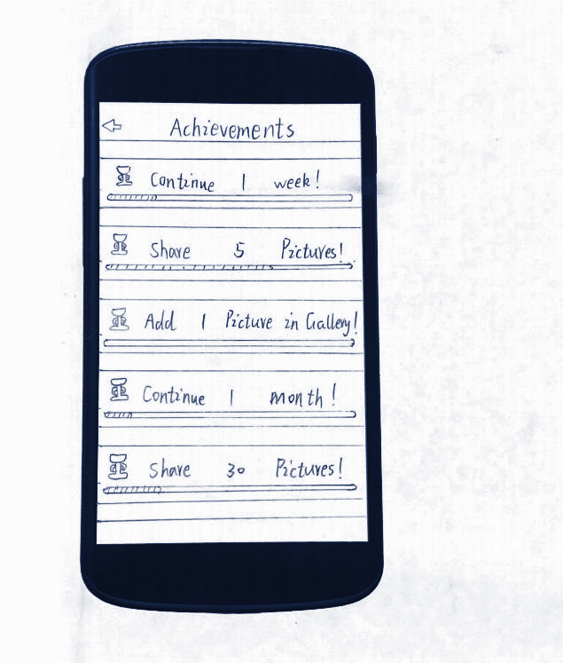
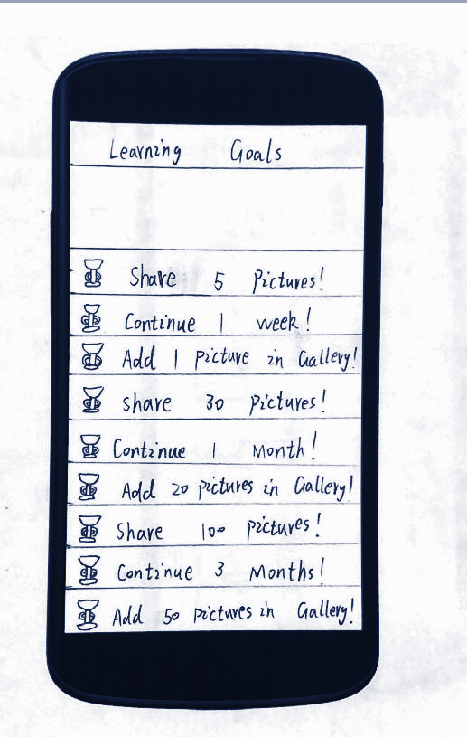
Design Ideas - Past Works & Milestones

Slide 20
Design Ideas - Shared Login
Share a public credential (username) with people you trust so they can go to your page and post critiques.
Reduces overhead of sharing images to get critiques.

Slide 21
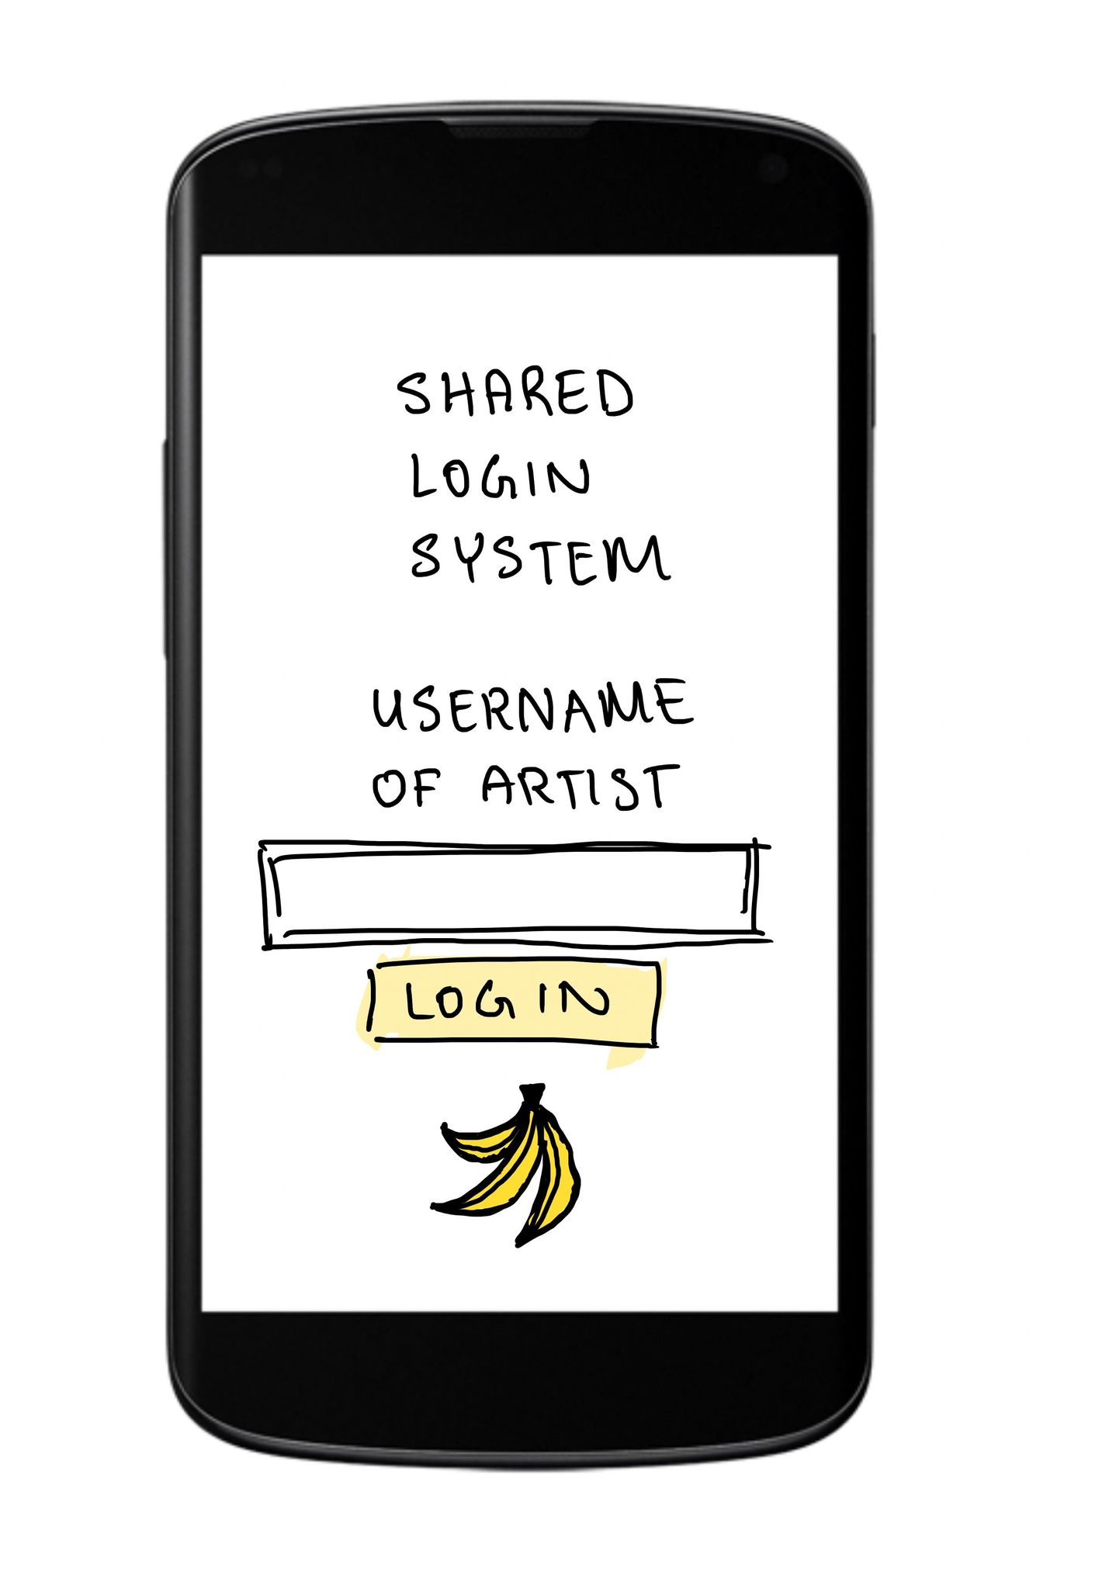
Design Ideas - User-linked Login

Slide 22
Thank you!

